Slide 1
Efficient Algorithms
Ekkapot Charoenwanit
Electrical and Computer Engineering (ECE)
TGGS
KMUTNB

Slide 2
Lecture 2: Mathematical Induction and Recurrence

Slide 3
What is Mathematical Induction?
It is a very useful and powerful proof technique.
It is a proof technique for mathematical/logical claims that involve natural numbers and discrete structures such as trees, graphs, computer programs etc.
It can prove claims that might be otherwise hard to prove using other proof techniques.

Slide 4
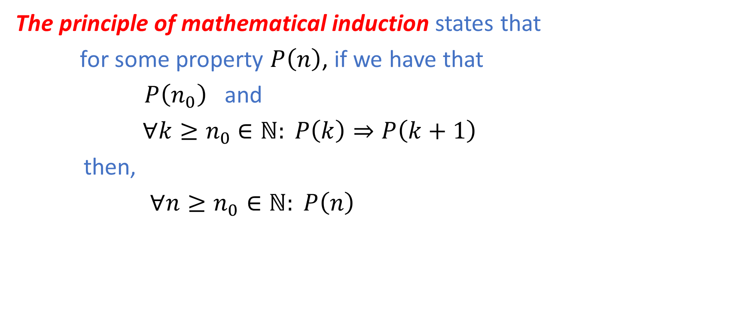
Mathematical Induction
The principle of mathematical induction states that
for some property $P\left(n\right)$, if we have that
$P\left(n_{0}\right)$ and
$∀k≥n_{0}$ $∈ℕ: P\left(k\right)⇒P\left(k+1\right)$
then,
$∀n≥n_{0}∈ℕ: P\left(n\right)$
Induction Hypothesis

Slide 5

Mathematical Induction
How induction works intuitively:
Suppose $n_{0}=0$.
It is true for $n=0$.
If it true for $n=0$, it is true for $n=1$.
If it true for $n=1$, it is true for $n=2$.
If it true for $n=2$, it is true for $n=3$.
…

Slide 6

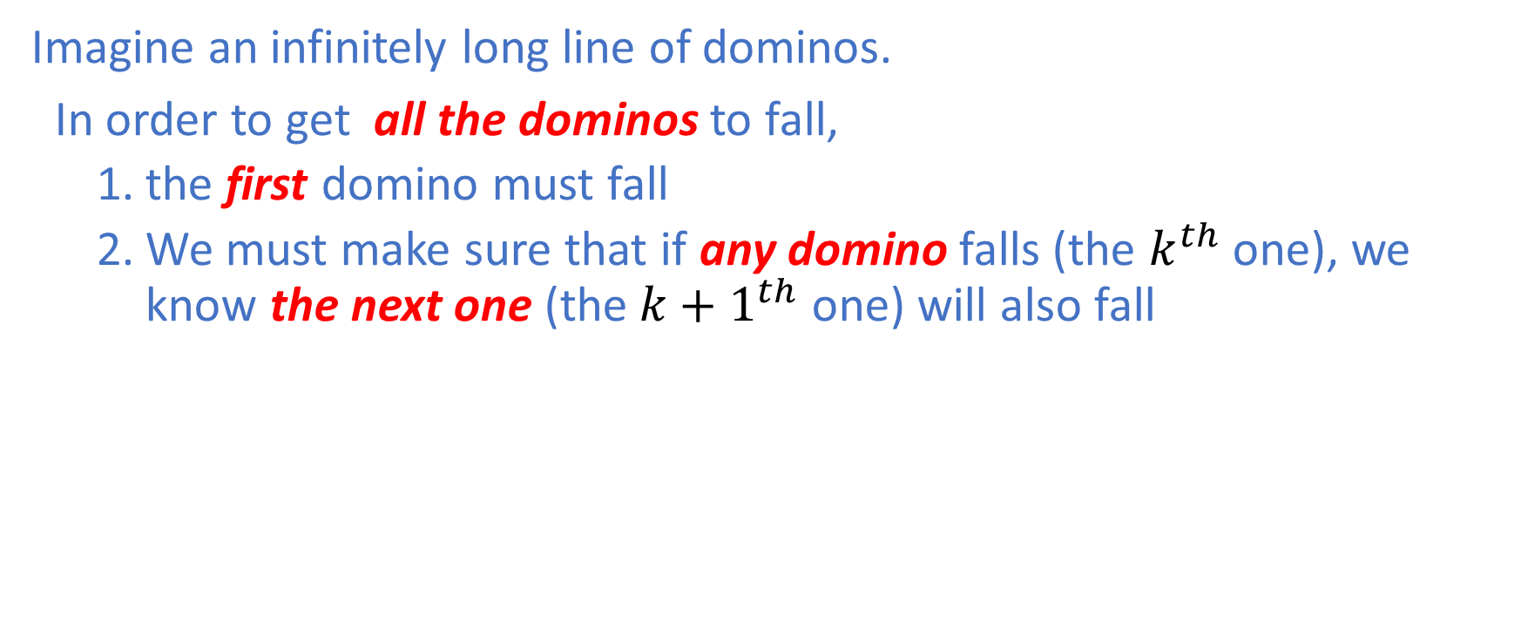
The Domino Effect
Imagine an infinitely long line of dominos.
In order to get all the dominos to fall,
the first domino must fall
We must make sure that if any domino falls (the $k^{th}$ one), we know the next one (the${k+1}^{th}$ one) will also fall
Illustration by Courtesy of Wikipedia

Slide 7
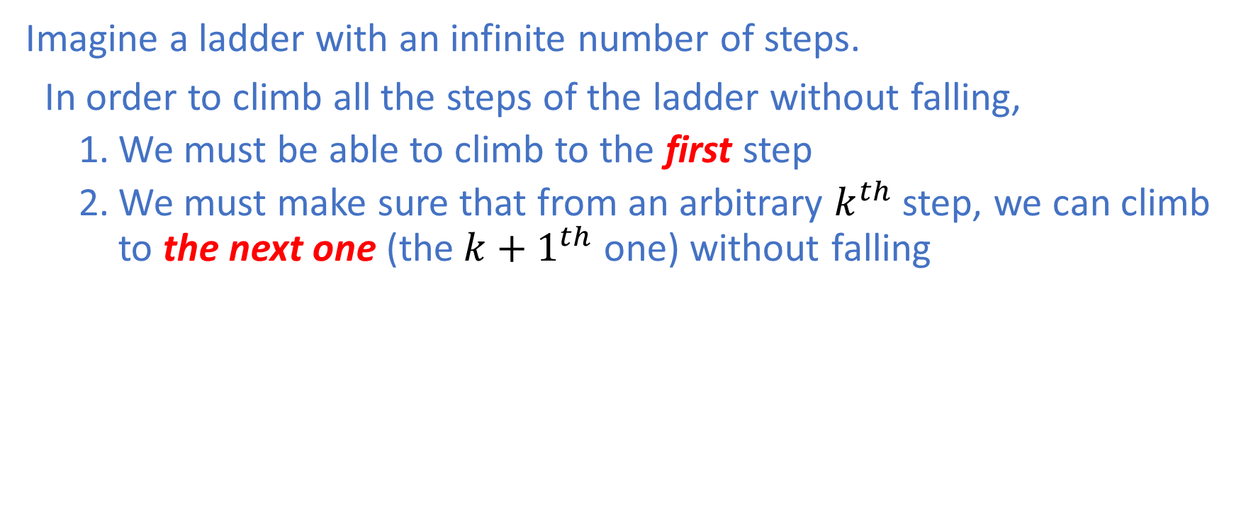
Another Way of Thinking: Climbing a ladder
Imagine a ladder with an infinite number of steps.
In order to climb all the steps of the ladder without falling,
We must be able to climb to the first step
We must make sure that from an arbitrary $k^{th}$ step, we can climb to the next one (the${k+1}^{th}$ one) without falling

Slide 8
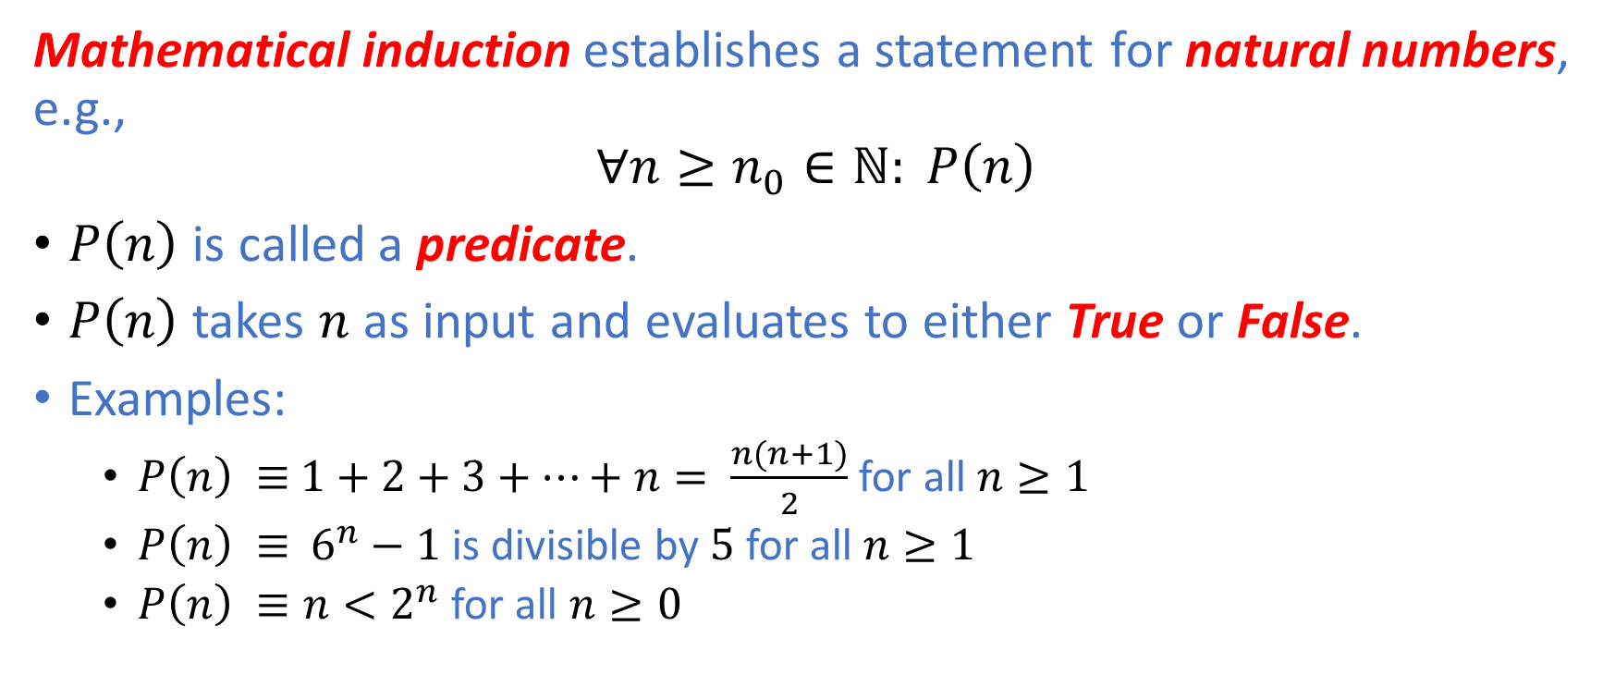
Mathematical Induction
Mathematical induction establishes a statement for natural numbers, e.g.,
$$∀n≥n_{0}∈ℕ: P\left(n\right)$$
$P\left(n\right)$ is called a predicate.
$P\left(n\right)$ takes $n$ as input and evaluates to either True or False.
Examples:
$P\left(n\right) ≡$ $1+2+3+…+n= \frac{n(n+1)}{2}$ for all $n≥1$
$P\left(n\right) ≡$ $6^{n}−1$ is divisible by $5$ for all $n≥1$
$P\left(n\right) ≡n<2^{n}$ for all $n≥0$

Slide 9
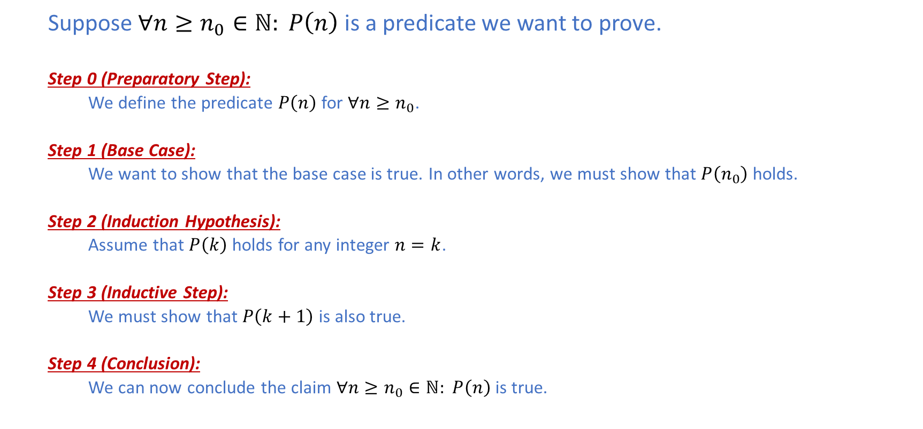
Proof Template
Suppose $∀n≥n_{0}∈ℕ: P\left(n\right)$ is a predicate we want to prove.
Step 0 (Preparatory Step):
We define the predicate $P\left(n\right)$ for $∀n≥n_{0}$.
Step 1 (Base Case):
We want to show that the base case is true. In other words, we must show that $P\left(n_{0}\right)$ holds.
Step 2 (Induction Hypothesis):
Assume that $P\left(k\right)$ holds for any integer $n=k$.
Step 3 (Inductive Step):
We must show that $P\left(k+1\right)$ is also true.
Step 4 (Conclusion):
We can now conclude the claim $∀n≥n_{0}∈ℕ: P\left(n\right)$ is true.

Slide 10
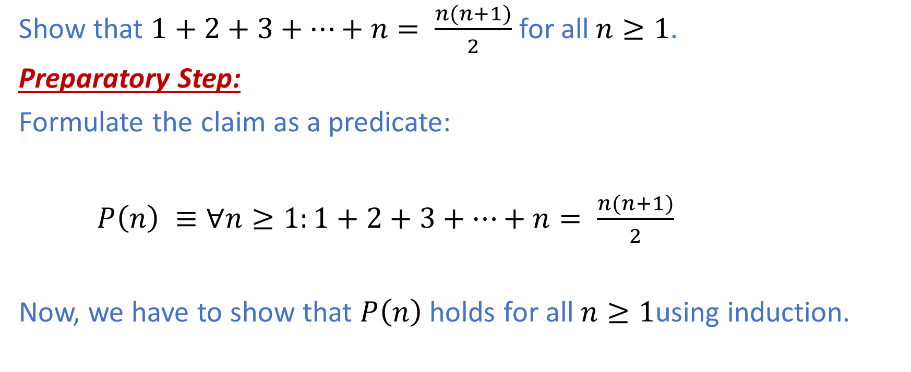

Example I: $1+2+3+…+n= \frac{n(n+1)}{2}$
Show that $1+2+3+…+n= \frac{n(n+1)}{2}$ for all$n≥1$.
Preparatory Step:
Formulate the claim as a predicate:
$P\left(n\right) ≡∀n≥1:1+2+3+…+n= \frac{n(n+1)}{2}$
Now, we have to show that $P\left(n\right)$holds for all$n≥1$using induction.

Slide 11
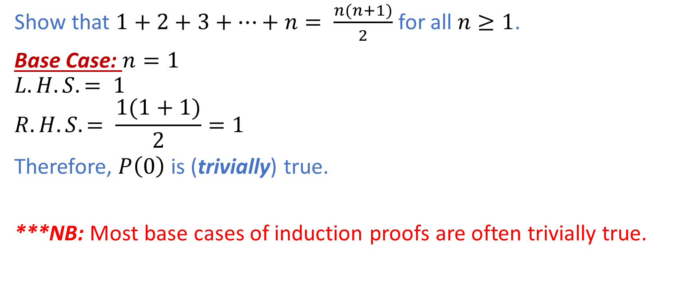
Example I: $1+2+3+…+n= \frac{n(n+1)}{2}$
Show that $1+2+3+…+n= \frac{n(n+1)}{2}$ for all $n≥1$.
Base Case: $n=1$
$$L.H.S. = 1$$
$$R.H.S. = \frac{1(1+1)}{2}=1$$
Therefore, $P\left(0\right)$ is (trivially) true.
***NB: Most base cases of induction proofs are often trivially true.

Slide 12
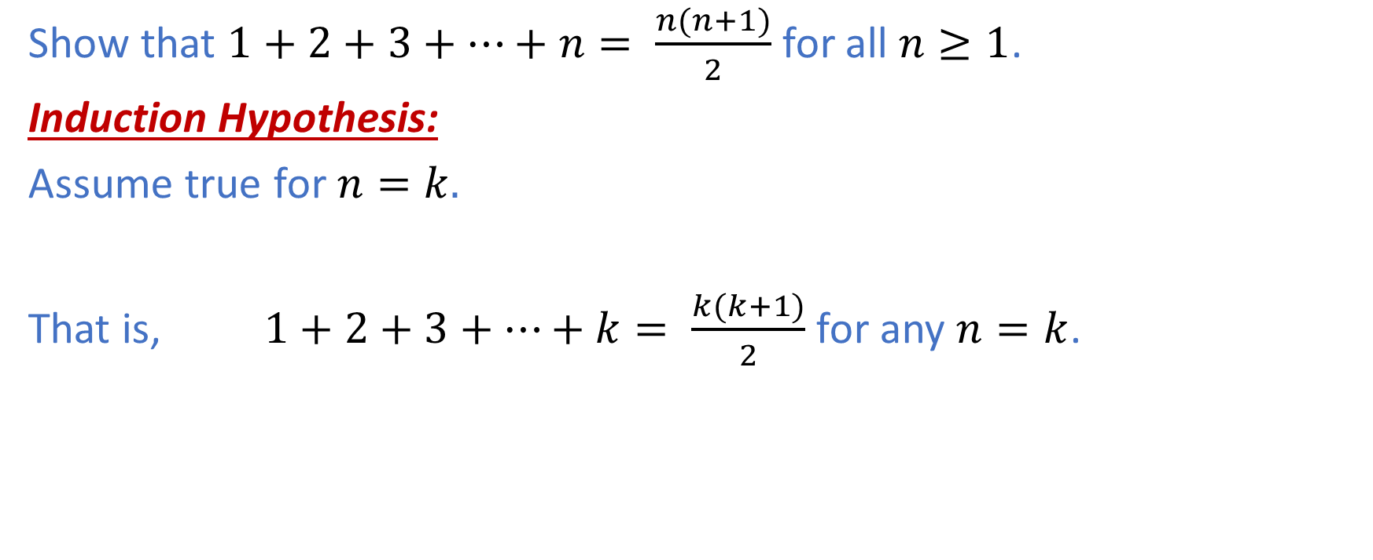
Example I: $1+2+3+…+n= \frac{n(n+1)}{2}$
Show that $1+2+3+…+n= \frac{n(n+1)}{2}$ for all $n≥1$.
Induction Hypothesis:
Assume true for $n=k.$
That is, $1+2+3+…+k= \frac{k(k+1)}{2}$ for any $n=k$.

Slide 13
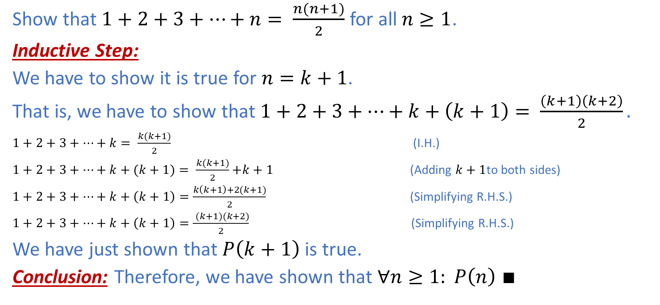
Example I: $1+2+3+…+n= \frac{n(n+1)}{2}$
Show that $1+2+3+…+n= \frac{n(n+1)}{2}$ for all$n≥1$.
Inductive Step:
We have to show it is true for $n=k+1$.
That is, we have to show that $1+2+3+…+k+\left(k+1\right)= \frac{\left(k+1\right)\left(k+2\right)}{2}.$
$1+2+3+…+k= \frac{k(k+1)}{2}$ (I.H.)
$1+2+3+…+k+(k+1)= \frac{k(k+1)}{2}$ $+k+1$ (Adding $k+1$to both sides)
$1+2+3+…+k+\left(k+1\right)=\frac{k\left(k+1\right)+2(k+1)}{2}$ (Simplifying R.H.S.)
$1+2+3+…+k+\left(k+1\right)=\frac{ (k+1)(k+2)}{2}$ (Simplifying R.H.S.)
We have just shown that $P\left(k+1\right)$ is true.
Conclusion: Therefore, we have shown that $∀n≥1: P\left(n\right)$ $∎$

Slide 14
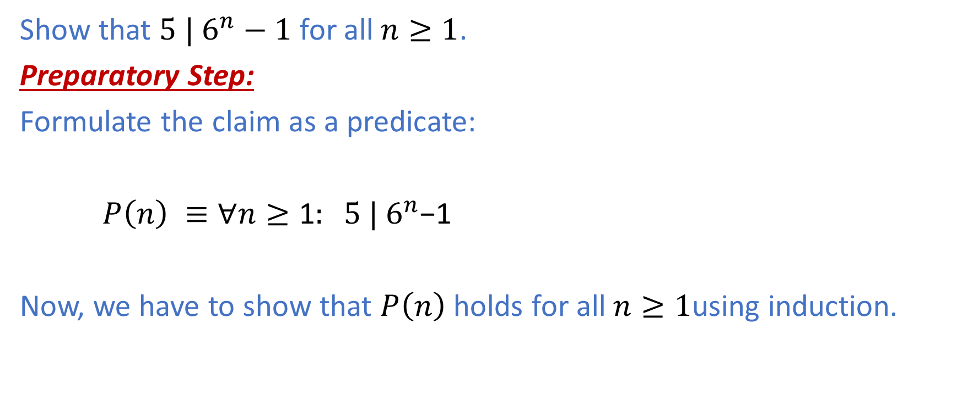

Example II: ${ 5 | 6}^{n}−1$
Show that ${5 | 6}^{n}−1$ for all$n≥1$.
Preparatory Step:
Formulate the claim as a predicate:
$P\left(n\right) ≡∀n≥\text{1}:{ 5 | 6}^{n}\text{−1}$
Now, we have to show that $P\left(n\right)$holds for all$n≥1$using induction.

Slide 15


Example II:${ 5 | 6}^{n}−1$
Show that ${5 | 6}^{n}−1$ for all$n≥1$.
Base Case: $n=1$
$${5 | 6}^{1}−1=5$$
Therefore, $P\left(0\right)$ is (trivially) true.

Slide 16

Example II:${ 5 | 6}^{n}−1$
Show that ${5 | 6}^{n}−1$ for all$n≥1$.
Induction Hypothesis:
Assume true for $n=k.$
That is, ${5 | 6}^{k}\text{−1}$ for any $n=k$.

Slide 17
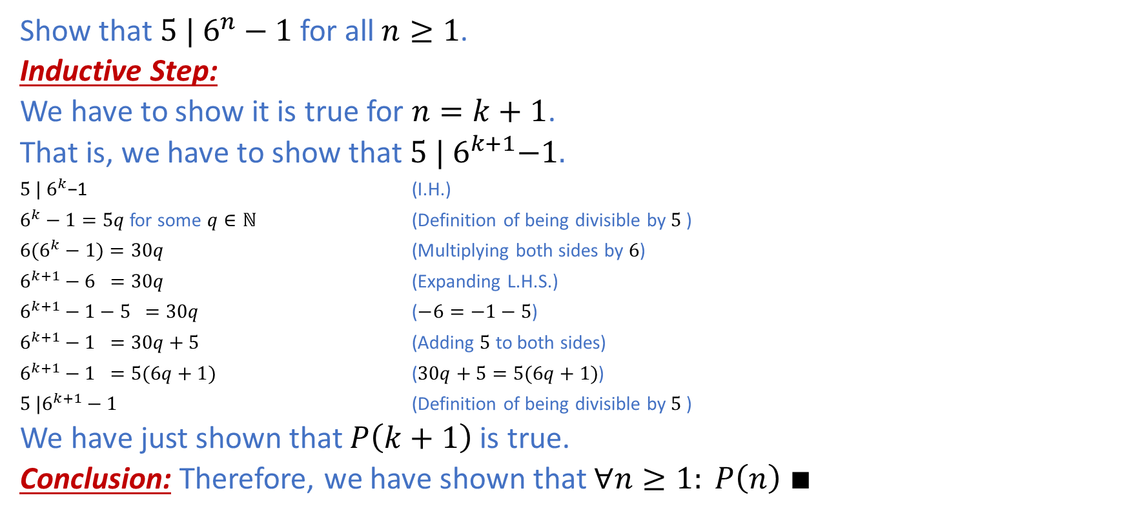
Example II:${ 5 | 6}^{n}−1$
Show that ${5 | 6}^{n}−1$ for all$n≥1$.
Inductive Step:
We have to show it is true for $n=k+1$.
That is, we have to show that${ 5 | 6}^{k+1}−1.$
${5 | 6}^{k}\text{−1}$ (I.H.)
$6^{k}−1=5q$for some $q∈ℕ$ (Definition of being divisible by $5$ )
${6(6}^{k}−1)=30q$ (Multiplying both sides by $6$)
$6^{k+1}−6 =30q$ (Expanding L.H.S.)
$6^{k+1}−1−5 =30q$ ($−6=−1−5$)
$6^{k+1}−1 =30q+5$ (Adding $5$ to both sides)
$6^{k+1}−1 =5(6q+1)$ ($30q+5=5(6q+1)$)
$5 |6^{k+1}−1$ (Definition of being divisible by $5$ )
We have just shown that $P\left(k+1\right)$ is true.
Conclusion: Therefore, we have shown that $∀n≥1: P\left(n\right)$ $∎$

Slide 18
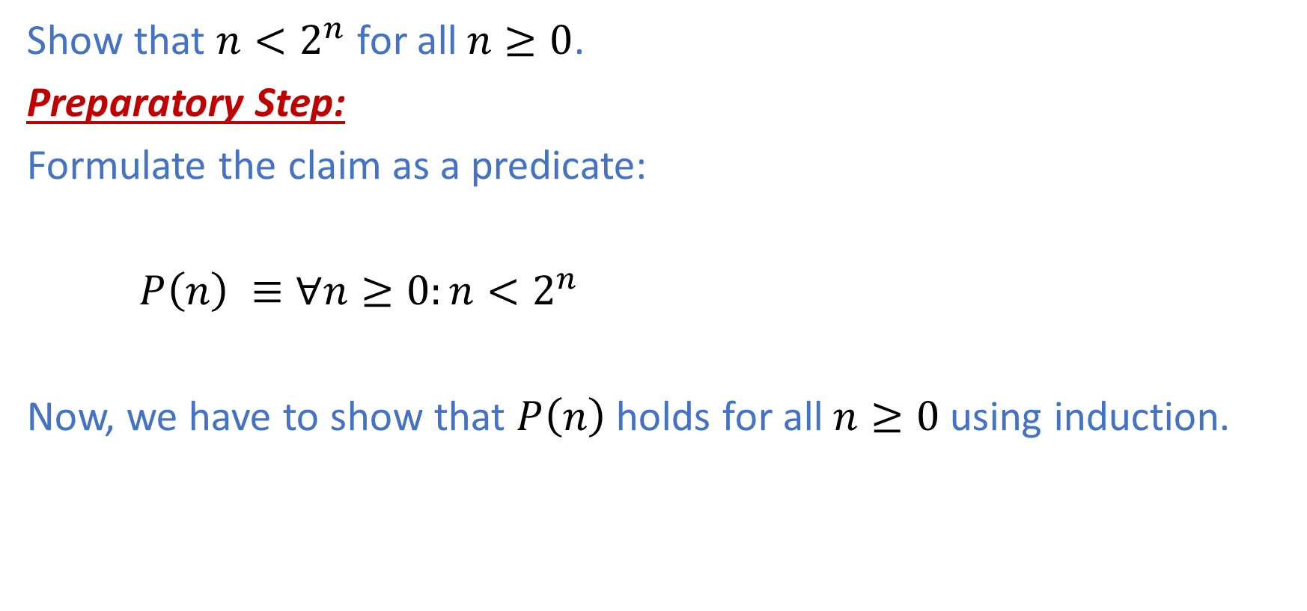

Example III: $n<2^{n}$
Show that $n<2^{n}$ for all$n≥0$.
Preparatory Step:
Formulate the claim as a predicate:
$P\left(n\right) ≡∀n≥\text{0}:n<2^{n}$
Now, we have to show that $P\left(n\right)$holds for all$n≥0$ using induction.

Slide 19


Example III:$n<2^{n}$
Show that $n<2^{n}$ for all$n≥0$.
Base Case: $n=0$
$$L.H.S. =0$$
$$R.H.S. =2^{0}=1$$
$$L.H.S. <R.H.S.$$
Therefore, $P\left(0\right)$ is (trivially) true.

Slide 20

Example III:$n<2^{n}$
Show that $n<2^{n}$ for all$n≥0$.
Induction Hypothesis:
Assume true for $n=k.$
That is, $k<2^{k}$ for any $n=k$.

Slide 21
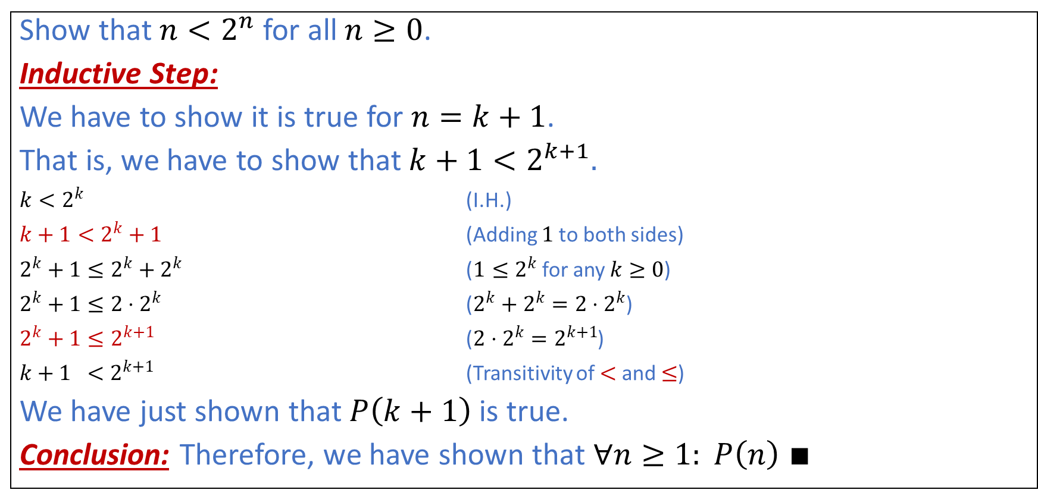
Example III:$n<2^{n}$
Show that $n<2^{n}$ for all$n≥0$.
Inductive Step:
We have to show it is true for $n=k+1$.
That is, we have to show that $k+1<2^{k+1}.$
$k<2^{k}$ (I.H.)
$k+1<2^{k}+1$ (Adding $1$to both sides)
$2^{k}+1≤2^{k}+2^{k}$ ($1≤2^{k}$for any $k≥0$)
$2^{k}+1≤2⋅2^{k}$ ($2^{k}+2^{k}=2⋅2^{k}$)
$2^{k}+1≤2^{k+1}$ ($2⋅2^{k}=2^{k+1}$)
$k+1 <$ $2^{k+1}$ (Transitivity of $<$ and $≤$)
We have just shown that $P\left(k+1\right)$ is true.
Conclusion: Therefore, we have shown that $∀n≥1: P\left(n\right)$ $∎$

Slide 22
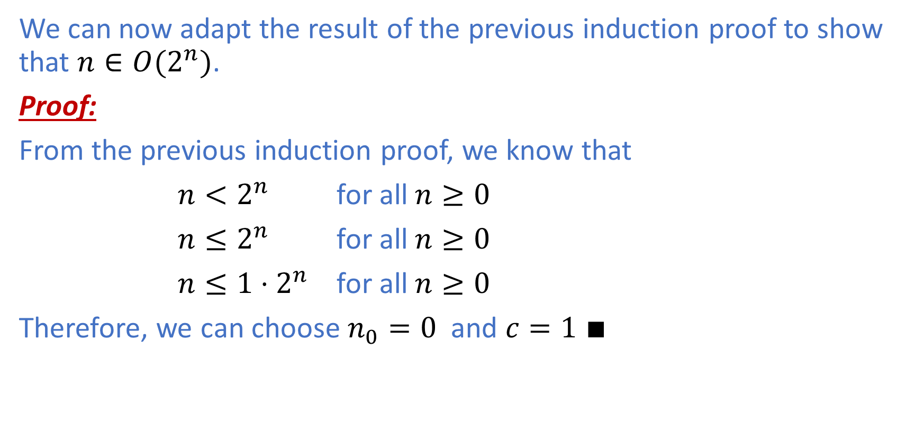

Proof of $n ∈{O(2}^{n})$
We can now adapt the result of the previous induction proof to show that $n∈{O(2}^{n})$.
Proof:
From the previous induction proof, we know that
$n<2^{n}$ for all$n≥0$
$n≤2^{n}$ for all$n≥0$
$n≤{1⋅2}^{n}$ for all$n≥0$
Therefore, we can choose $n_{0}=0$ and $c=1 ∎$

Slide 23
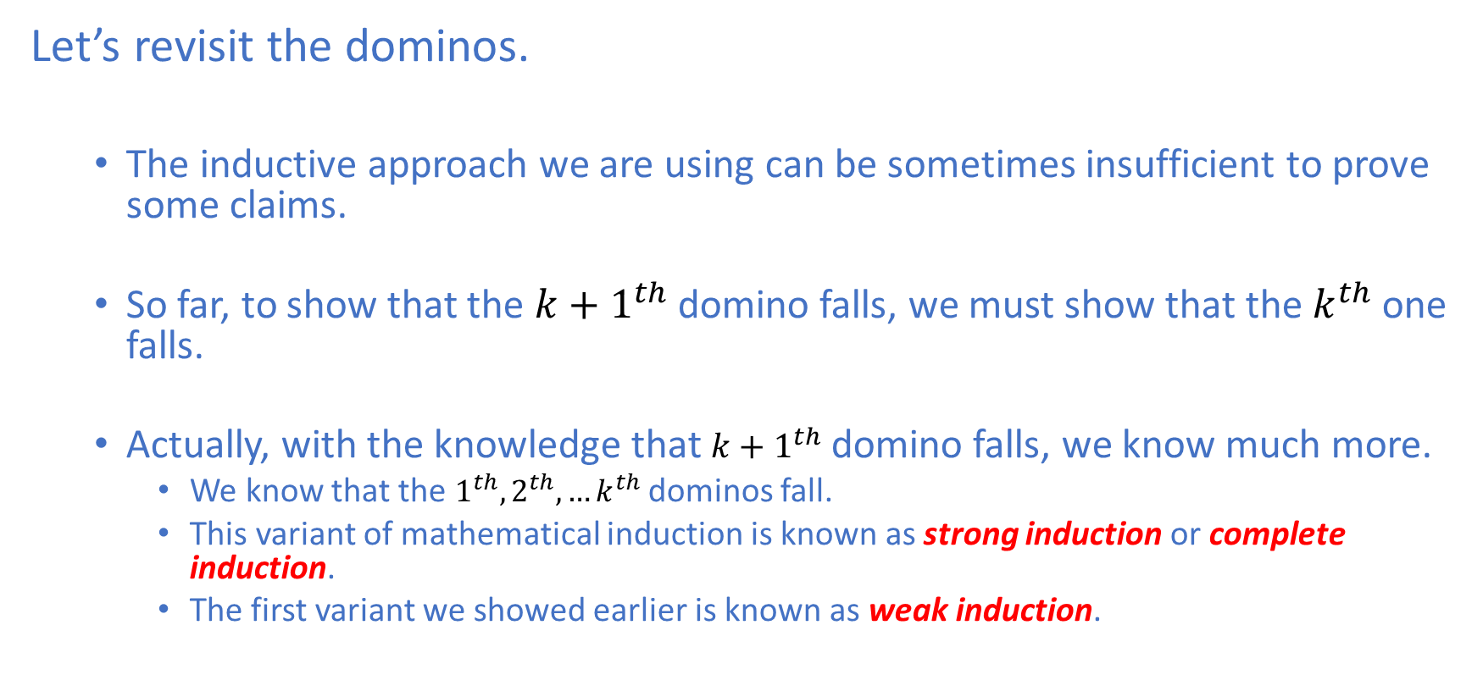
Revisiting the Dominos
Let’s revisit the dominos.
The inductive approach we are using can be sometimes insufficient to prove some claims.
So far, to show that the ${k+1}^{th}$ domino falls, we must show that the $k^{th}$ one falls.
Actually, with the knowledge that ${k+1}^{th}$ domino falls, we know much more.
We know that the $1^{th},2^{th},…k^{th}$dominos fall.
This variant of mathematical induction is known as strong induction or complete induction.
The first variant we showed earlier is known as weak induction.

Slide 24
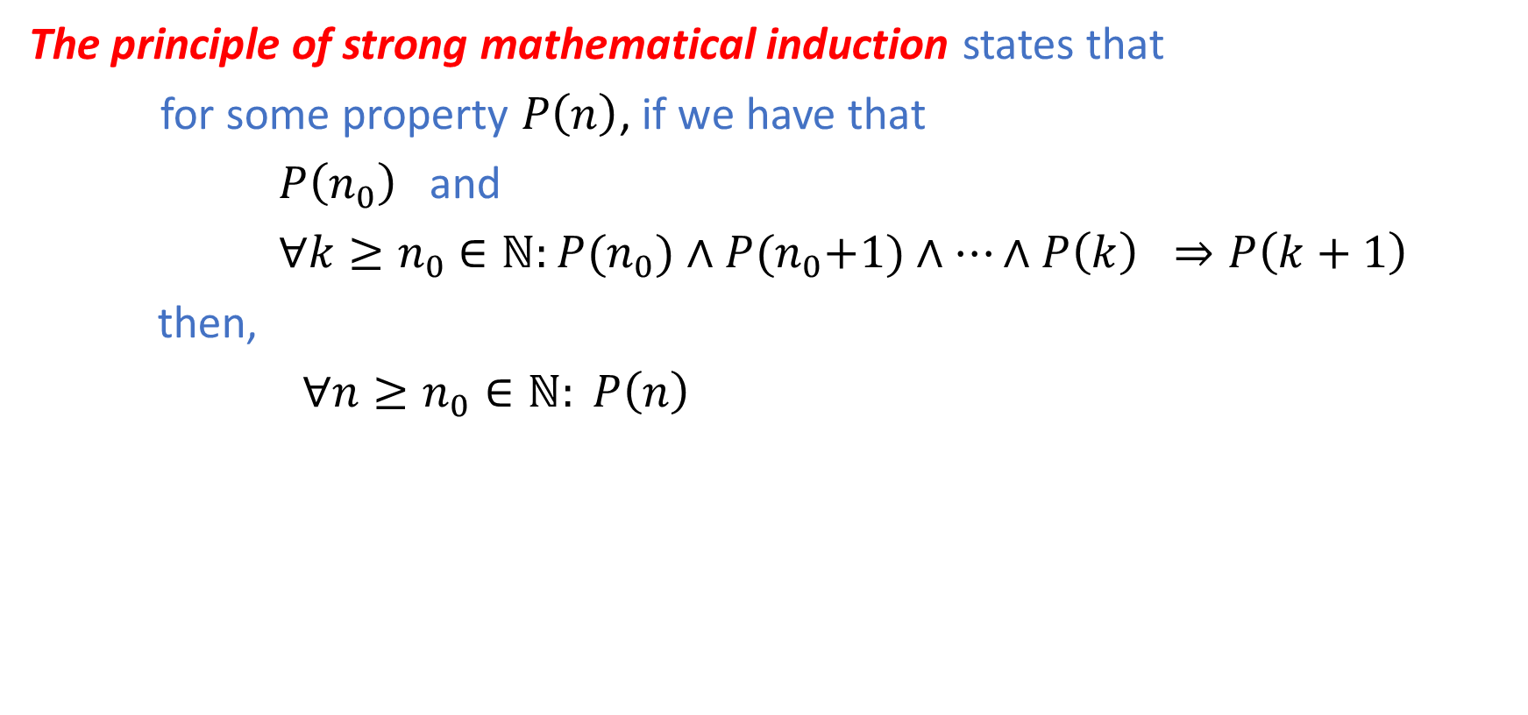
Strong Mathematical Induction
The principle of strong mathematical induction states that
for some property $P\left(n\right)$, if we have that
$P\left(n_{0}\right)$ and
$∀k≥n_{0}$ $∈ℕ:P{(n}_{0})∧P{(n}_{0}+1)∧…∧P\left(k\right) ⇒P\left(k+1\right)$
then,
$∀n≥n_{0}∈ℕ: P\left(n\right)$
Induction Hypothesis

Slide 25
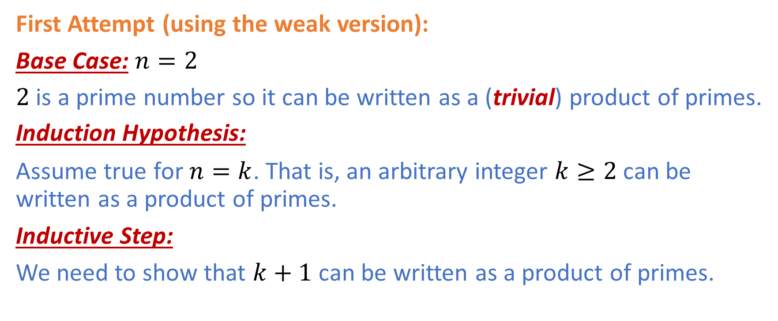

Example I: Every integer $n>1$ can be written as a product of primes.
First Attempt (using the weak version):
Base Case: $n=2$
$2$ is a prime number so it can be written as a (trivial) product of primes.
Induction Hypothesis:
Assume true for $n=k$. That is, an arbitrary integer $k≥2$can be written as a product of primes.
Inductive Step:
We need to show that $k+1$ can be written as a product of primes.

Slide 26
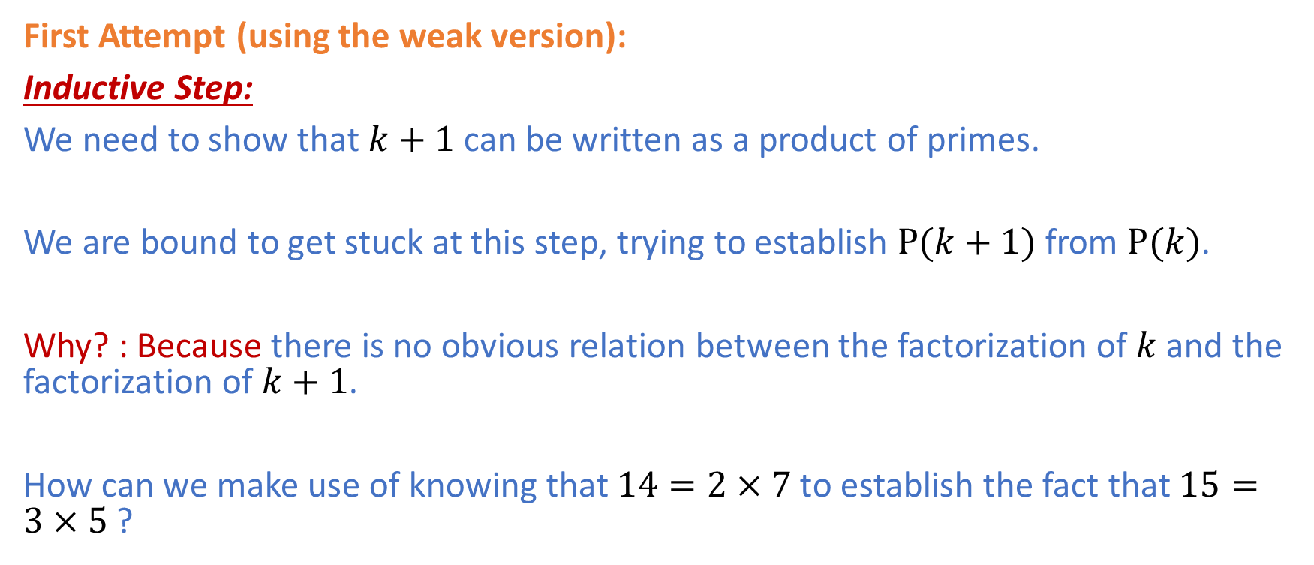
Example I: Every integer $n>1$ can be written as a product of primes.
First Attempt (using the weak version):
Inductive Step:
We need to show that $k+1$ can be written as a product of primes.
We are bound to get stuck at this step, trying to establish $P(k+1)$ from $P(k)$.
Why? : Because there is no obvious relation between the factorization of $k$ and the factorization of $k+1$.
How can we make use of knowing that $14=2×7$ to establish the fact that $15=3×5$ ?

Slide 27
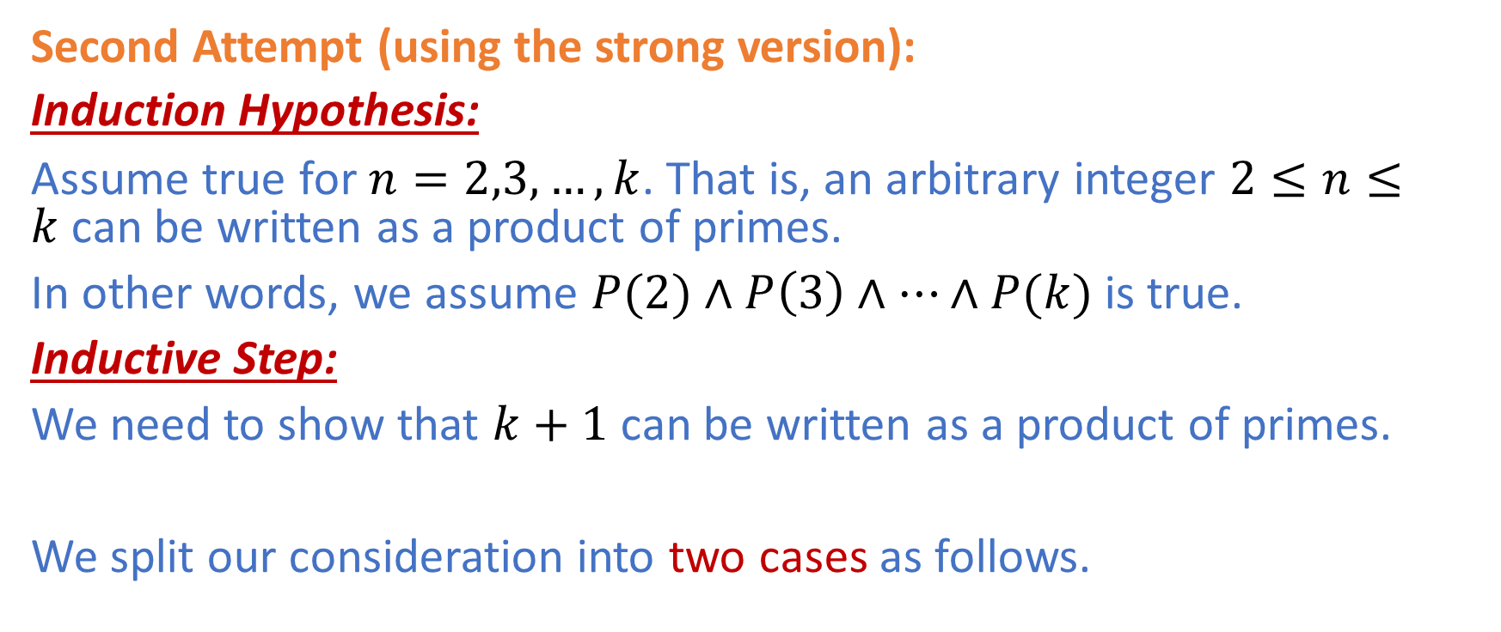
Example I: Every integer $n>1$ can be written as a product of primes.
Second Attempt (using the strong version):
Induction Hypothesis:
Assume true for $n=2,3,…,k$. That is, an arbitrary integer $2≤n≤k$can be written as a product of primes.
In other words, we assume $P(2)∧P\left(3\right)∧…∧P(k)$ is true.
Inductive Step:
We need to show that $k+1$ can be written as a product of primes.
We split our consideration into two cases as follows.

Slide 28
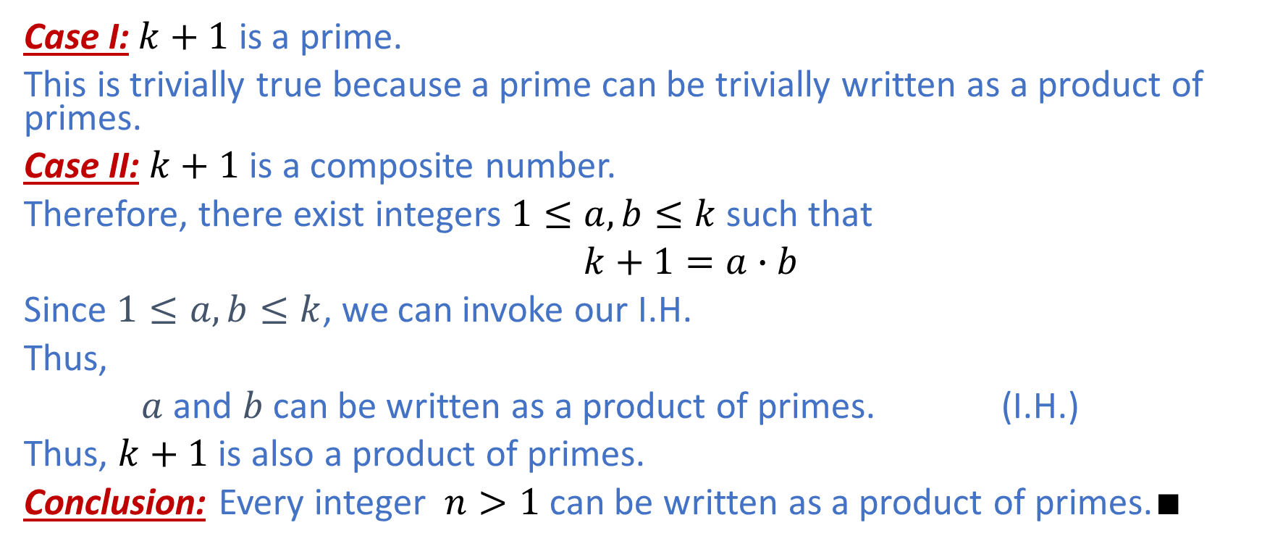
Example I: Every integer $n>1$ can be written as a product of primes.
Case I: $k+1$ is a prime.
This is trivially true because a prime can be trivially written as a product of primes.
Case II: $k+1$ is a composite number.
Therefore, there exist integers $1≤a,b≤k$ such that
$k+1=a∙b$
Since $1≤a,b≤k$, we can invoke our I.H.
Thus,
$a$ and $b$ can be written as a product of primes. (I.H.)
Thus, $k+1$ is also a product of primes.
Conclusion: Every integer $n>1$ can be written as a product of primes.$∎$

Slide 29
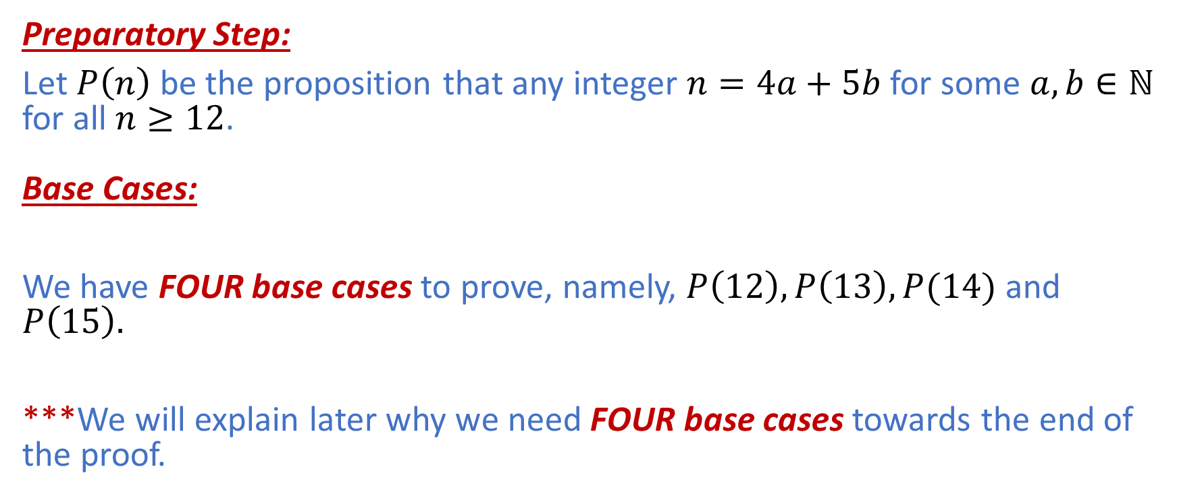

Example II: $n=4a+5b$ for all $n≥12$.
Preparatory Step:
Let $P\left(n\right)$ be the proposition that any integer $n=4a+5b$for some $a,b∈ℕ$ for all $n≥12$. Base Cases:
We have FOUR base cases to prove, namely, $P\left(12\right),P\left(13\right),P(14)$ and $P\left(15\right).$
***We will explain later why we need FOUR base cases towards the end of the proof.

Slide 30
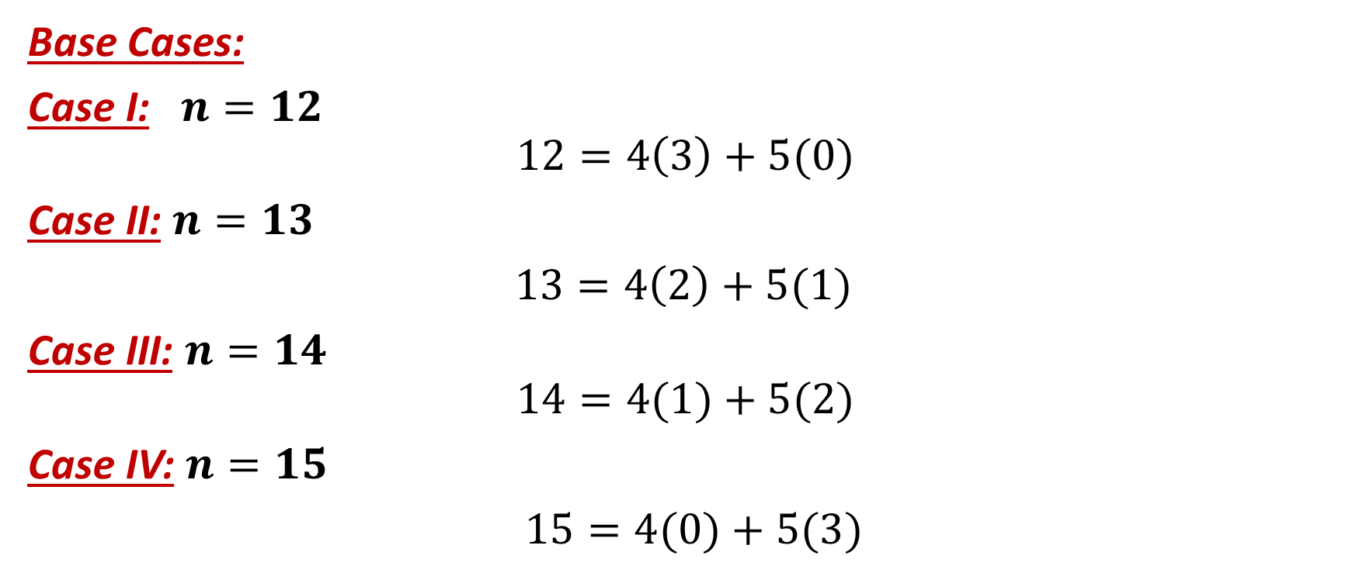
Example II: $n=4a+5b$ for all $n≥12$.
Base Cases:
Case I: $n=12$
$$12=4\left(3\right)+5(0)$$
Case II: $n=13$
$13=4\left(2\right)+5(1)$
Case III: $n=14$
$$14=4(1)+5(2)$$
Case IV: $n=15$
$15=4(0)+5(3)$

Slide 31
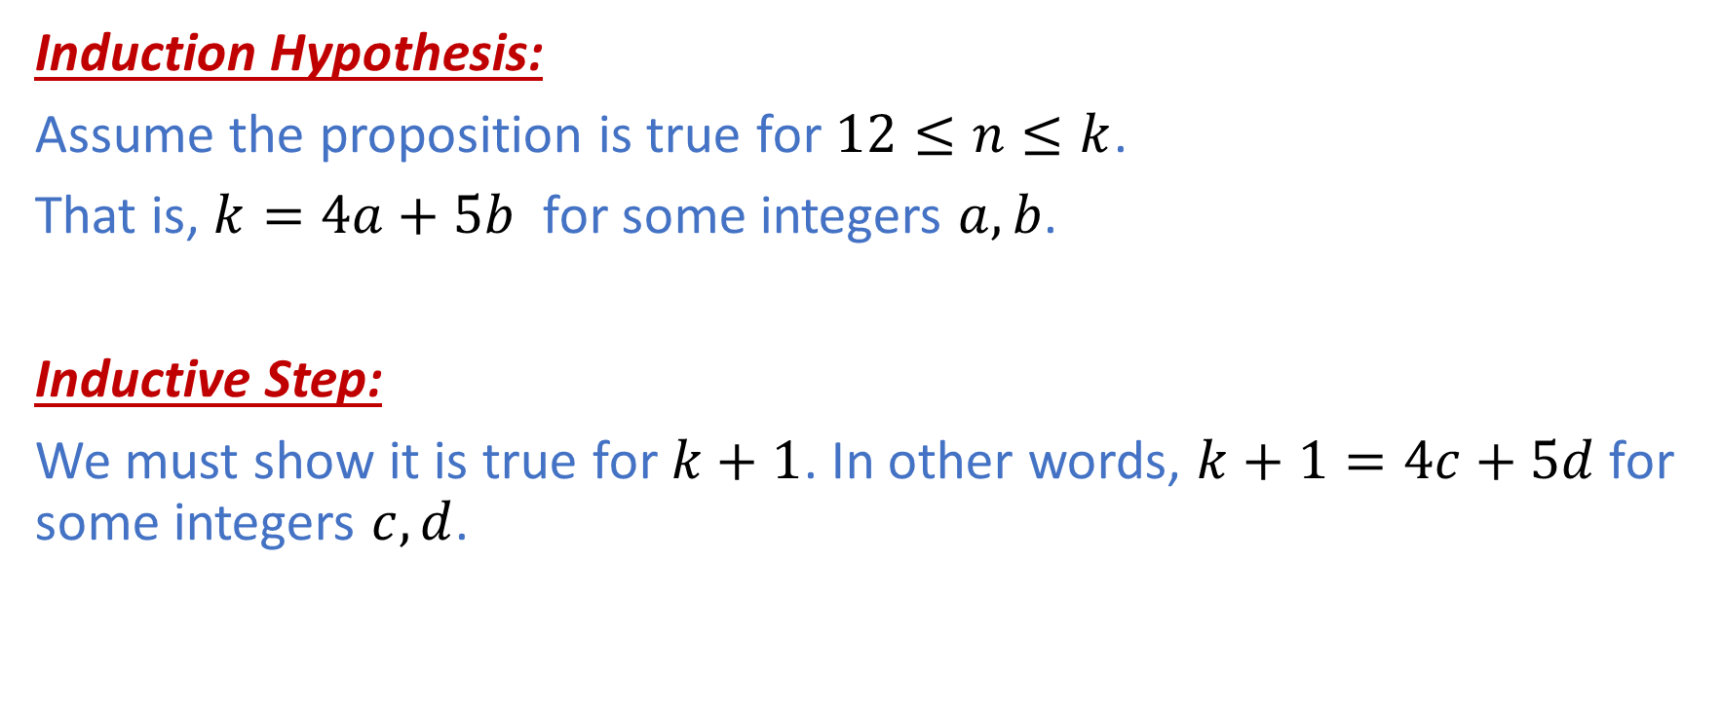
Example II: $n=4a+5b$ for all $n≥12$.
Induction Hypothesis:
Assume the proposition is true for $12≤n≤k$.
That is, $k=4a+5b$ for some integers $a,b$.
Inductive Step:
We must show it is true for $k+1$. In other words, $k+1=4c+5d$ for some integers $c,d$.

Slide 32
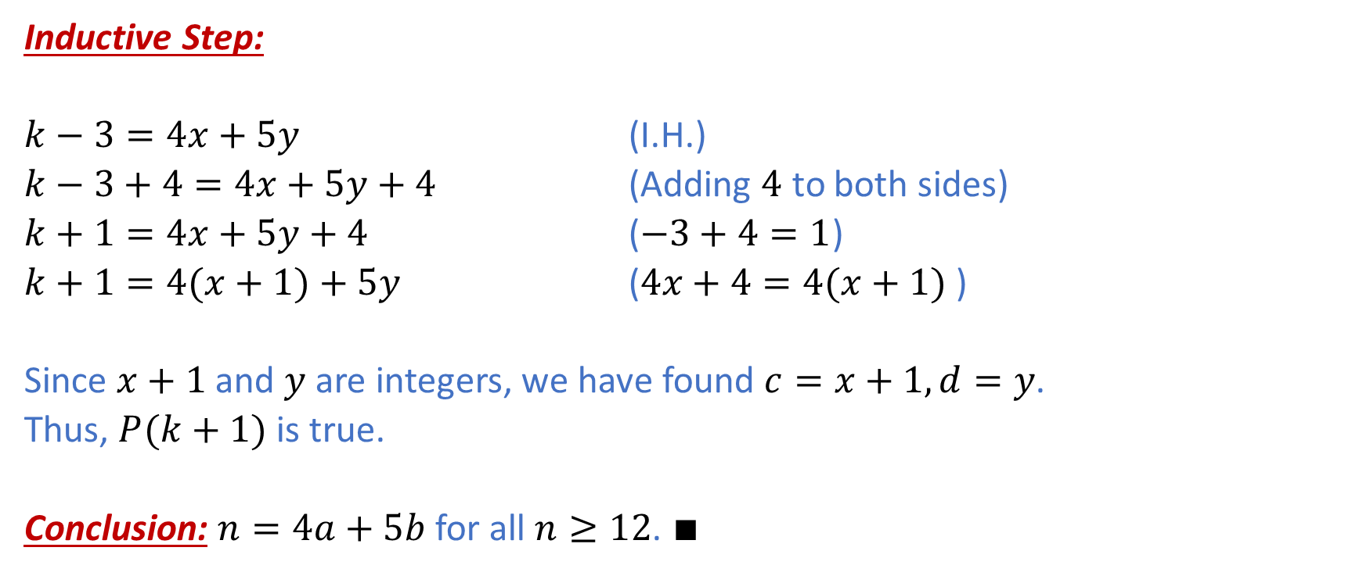

Example II: $n=4a+5b$ for all $n≥12$.
Inductive Step:
$k−3=4x+5y$ (I.H.)
$k−3+4=4x+5y+4$ (Adding $4$ to both sides)
$k+1=4x+5y+4$ ($−3+4=1$)
$k+1=4(x+1)+5y$ ($4x+4=4(x+1)$)
Since $x+1$ and $y$ are integers, we have found $c=x+1,d=y$.
Thus, $P(k+1)$ is true.
Conclusion: $n=4a+5b$ for all $n≥12$. $∎$

Slide 33
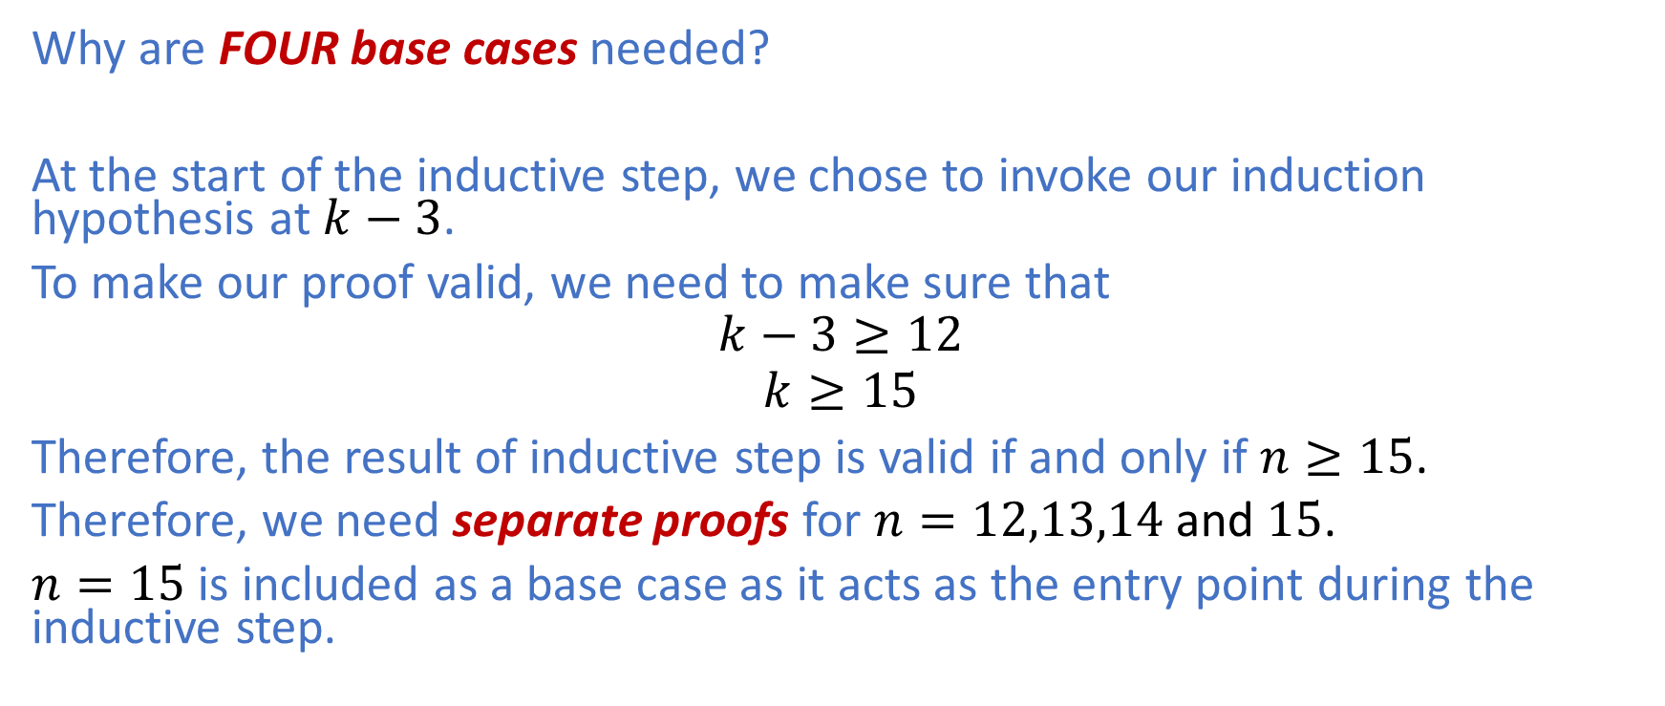
Example II: $n=4a+5b$ for all $n≥12$.
Why are FOUR base cases needed?
At the start of the inductive step, we chose to invoke our induction hypothesis at $k−3$.
To make our proof valid, we need to make sure that
$$k−3≥12$$
$$k≥15$$
Therefore, the result of inductive step is valid if and only if $n≥15$.
Therefore, we need separate proofs for $n=12,13,14$ and $15$.
$n=15$ is included as a base case as it acts as the entry point during the inductive step.

Slide 34
Summary
Mathematical induction is a very powerful tool for proving statements for natural numbers and discrete structures.
However, it does not provide any intuition as to why the result is true
We can use other proof techniques to prove statements mathematical induction can be used to prove.
,e.g., direct proof, proof by contradiction, proof by contrapositive
These proofs provide intuition and logic behind the result.

Slide 35
Recursion
A circular (aka recursive) definition is often regarded as not useful.
However, in mathematics, especially in computer science, we always come across recursive definitions to define concepts in terms of themselves.
Many algorithms can be expressed recursively more naturally than iteratively.

Slide 36



Example I: The Factorial of a Number
We can define the factorial of a number recursively as follows:
$$n!= \left\{\begin{aligned}1 \\ n∙\left(n−1\right)!\end{aligned}\right.$$
$$n=0$$
$n>0$
We can see great similarity between recursion and induction.
Actually, they are closely related.
The base case of a recursive definition is akin to the base case of mathematical induction.
The recursive case is akin to the inductive step in mathematical induction.

Slide 37
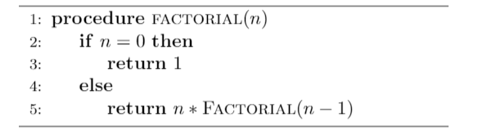
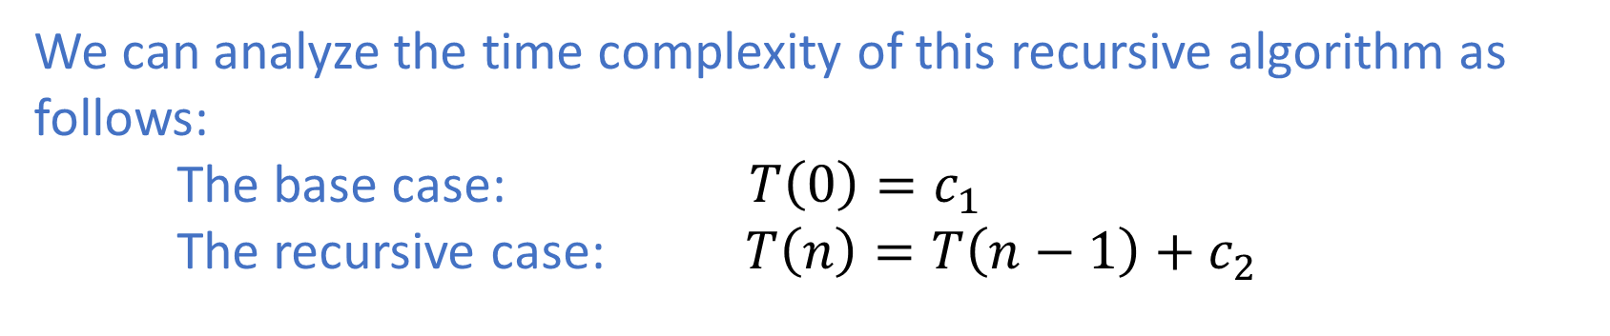
Example I: The Factorial of a Number
We can analyze the time complexity of this recursive algorithm as follows:
The base case: $T\left(0\right)=c_{1}$
The recursive case: $T\left(n\right)=T\left(n−1\right)+c_{2}$

Slide 38
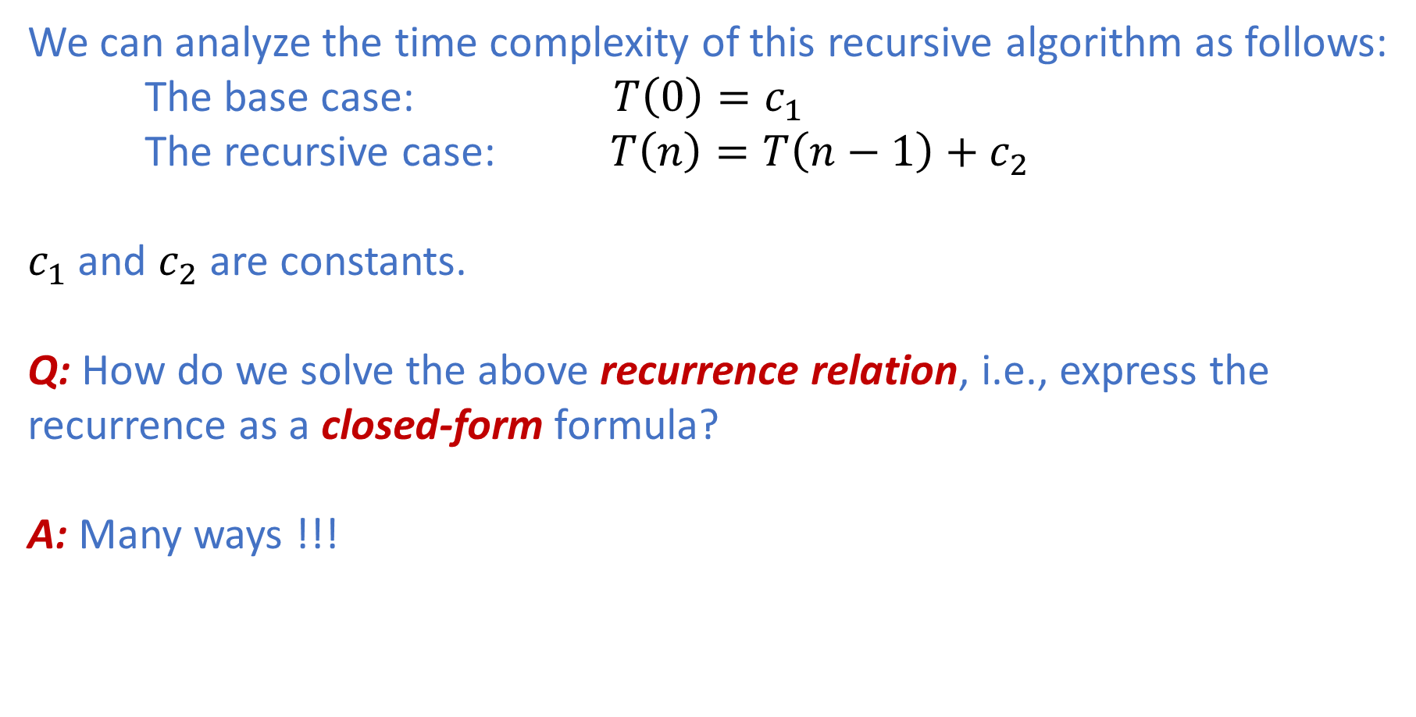
Example I: The Factorial of a Number
We can analyze the time complexity of this recursive algorithm as follows:
The base case: $T\left(0\right)=c_{1}$
The recursive case: $T\left(n\right)=T\left(n−1\right)+c_{2}$
$c_{1}$ and $c_{2}$ are constants.
Q: How do we solve the above recurrence relation, i.e., express the recurrence as a closed-form formula?
A: Many ways !!!

Slide 39
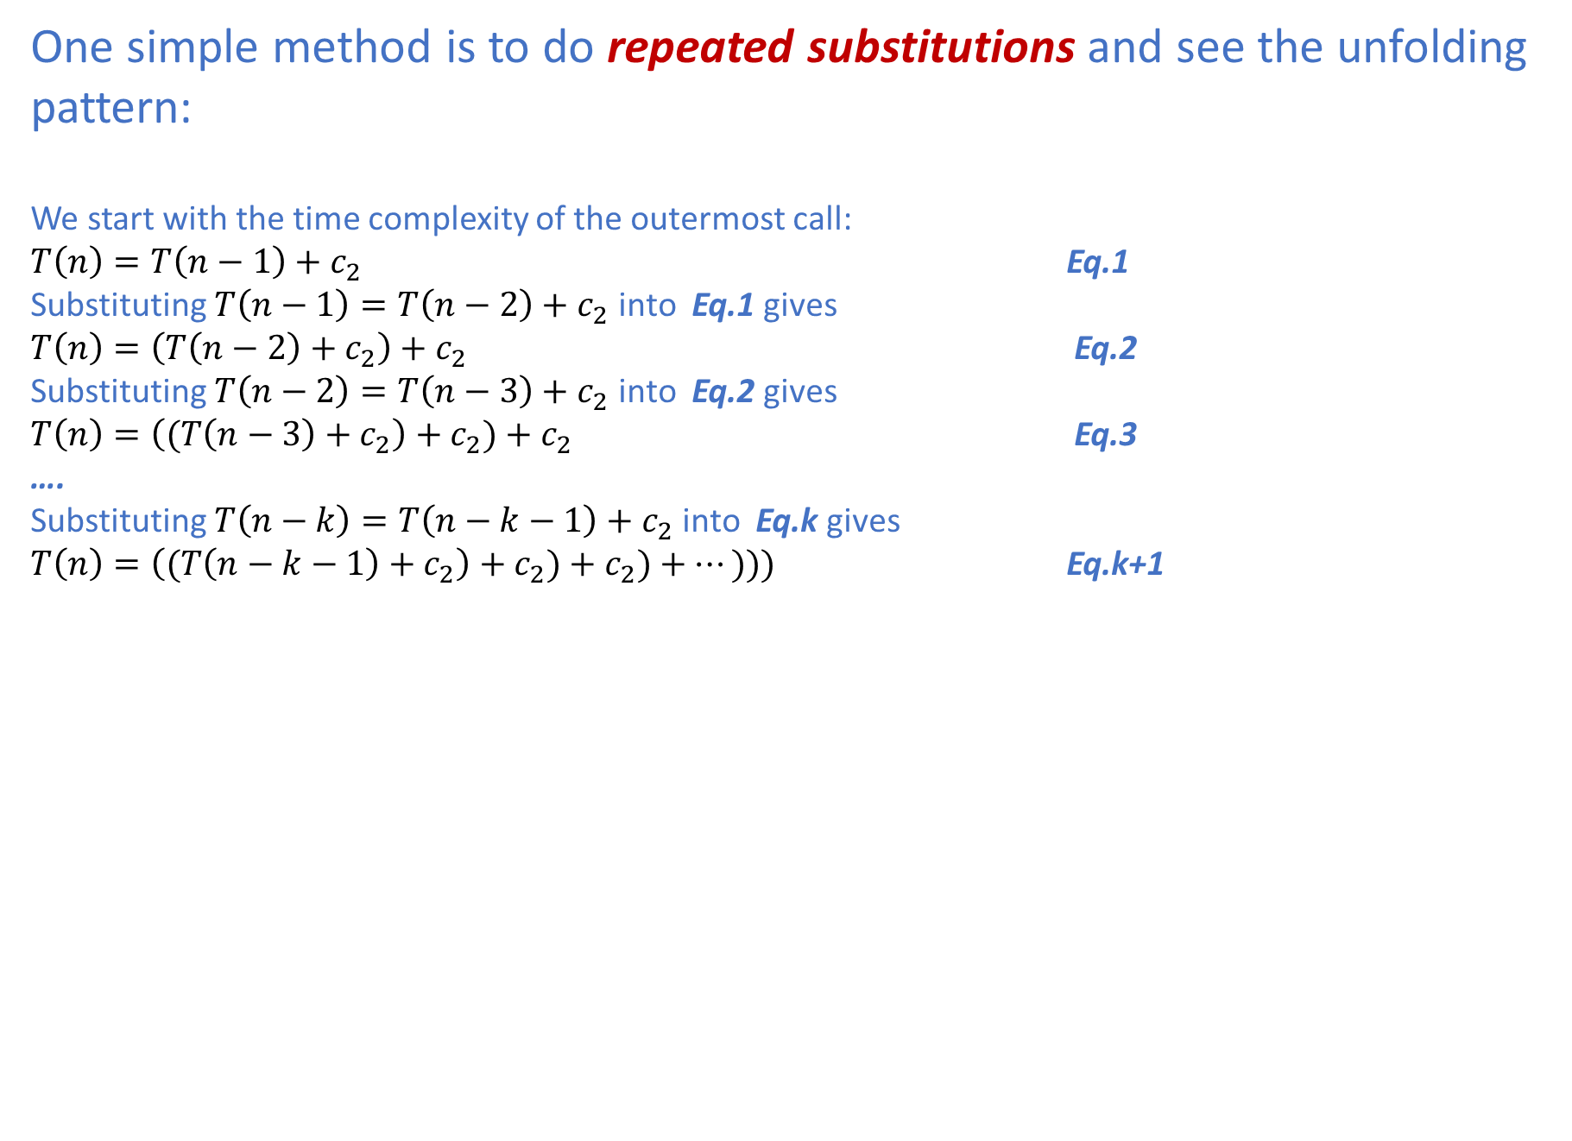
Example I: The Factorial of a Number
One simple method is to do repeated substitutions and see the unfolding pattern:
We start with the time complexity of the outermost call:
$T\left(n\right)=T\left(n−1\right)+c_{2}$ Eq.1
Substituting $T\left(n−1\right)=T\left(n−2\right)+c_{2}$ into Eq.1 gives
$T\left(n\right)=\left(T\left(n−2\right)+c_{2}\right)+c_{2}$ Eq.2
Substituting $T\left(n−2\right)=T\left(n−3\right)+c_{2}$ into Eq.2 gives
$T\left(n\right)=\left((T\left(n−3\right)+c_{2}\right)+c_{2})+c_{2}$ Eq.3
….
Substituting $T\left(n−k\right)=T\left(n−k−1\right)+c_{2}$ into Eq.k gives
$T\left(n\right)=\left((T\left(n−k−1\right)+c_{2}\right)+c_{2})+c_{2})+…)))$ Eq.k+1

Slide 40
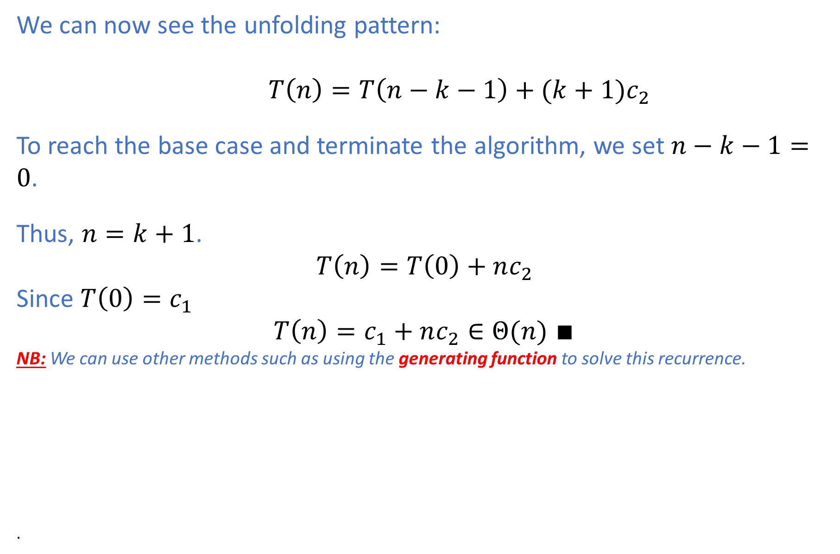
Example I: The Factorial of a Number
We can now see the unfolding pattern:
$T\left(n\right)=T\left(n−k−1\right)+(k+1)c_{2}$
To reach the base case and terminate the algorithm, we set $n−k−1=0$.
Thus, $n=k+1$.
$$T\left(n\right)=T\left(0\right)+nc_{2}$$
Since $T\left(0\right)=c_{1}$
$T\left(n\right)=c_{1}+nc_{2}∈Θ(n)$ $∎$
NB: We can use other methods such as using the generating function to solve this recurrence.
.

Slide 41
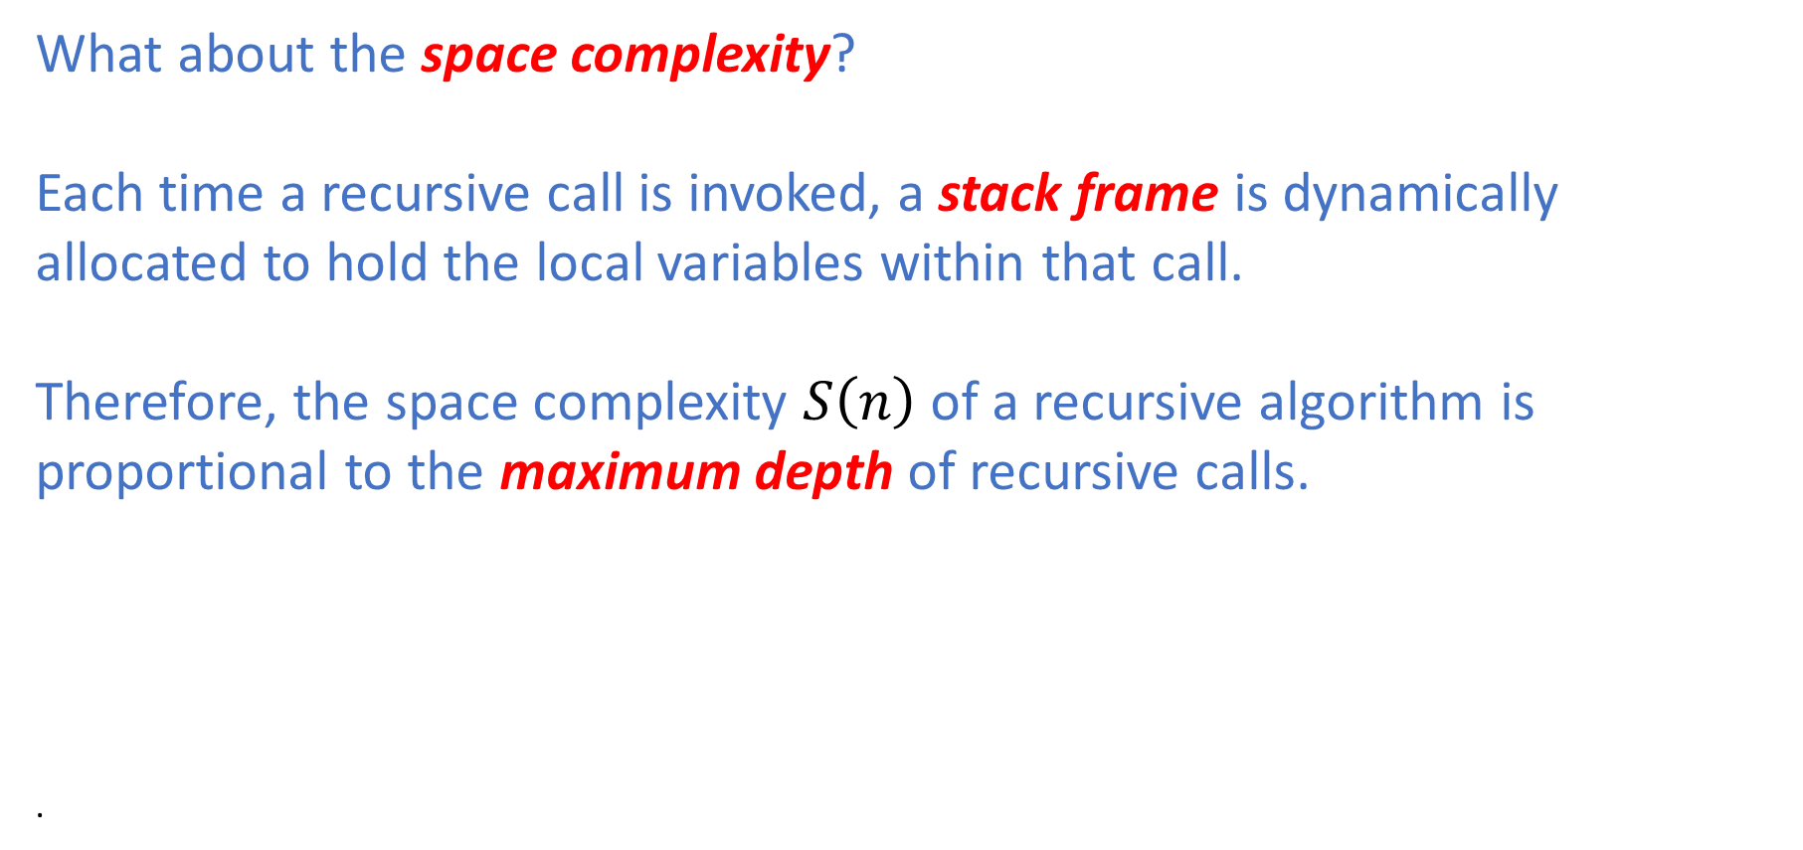
Space Complexity
What about the space complexity?
Each time a recursive call is invoked, a stack frame is dynamically allocated to hold the local variables within that call.
Therefore, the space complexity $S\left(n\right)$ of a recursive algorithm is proportional to the maximum depth of recursive calls.
.

Slide 42
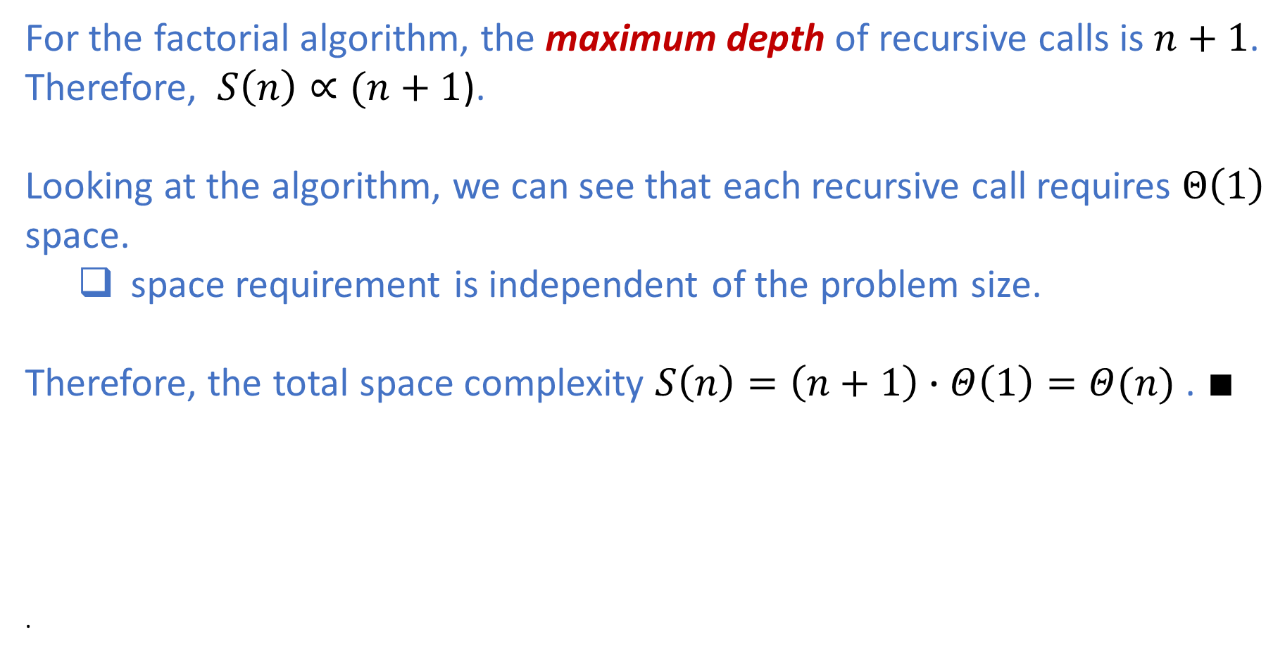
Space Complexity: The Factorial Algorithm
For the factorial algorithm, the maximum depth of recursive calls is $n+1$.
Therefore, $S\left(n\right)∝(n+1$).
Looking at the algorithm, we can see that each recursive call requires $Θ\left(1\right)$
space.
space requirement is independent of the problem size.
Therefore, the total space complexity $S\left(n\right)=\left(n+1\right)∙Θ\left(1\right)=Θ(n)$ . $∎$
.

Slide 43
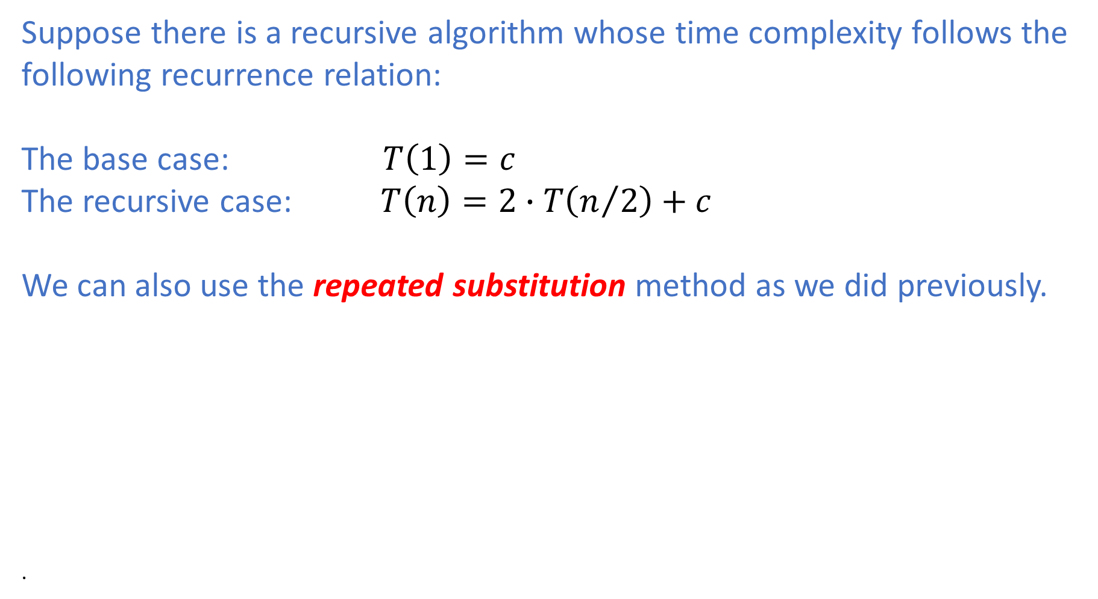
The Recursion Tree Method
Suppose there is a recursive algorithm whose time complexity follows the following recurrence relation:
The base case: $T\left(1\right)=c$
The recursive case: $T\left(n\right)=2∙T\left(n/2\right)+c$
We can also use the repeated substitution method as we did previously.
.

Slide 44


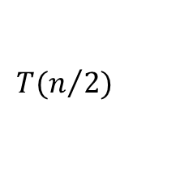













The Recursion Tree Method
Total work at each level
$$T(n)$$
c
$$c$$
$$T(n/2)$$
$$T(n/2)$$
c
c
2$c$
$$T(n/4)$$
$$T(n/4)$$
$$T(n/4)$$
$$T(n/4)$$
c
c
c
$$4c$$
c
$$T(n/{2^{k}})$$
$$T(n/{2^{k}})$$
$$T(n/{2^{k}})$$
$$T(n/{2^{k}})$$
c
c
c
c
$$2^{k}c$$
$T\left(n\right)=c(1+2+4+…+2^{k}$)

Slide 45
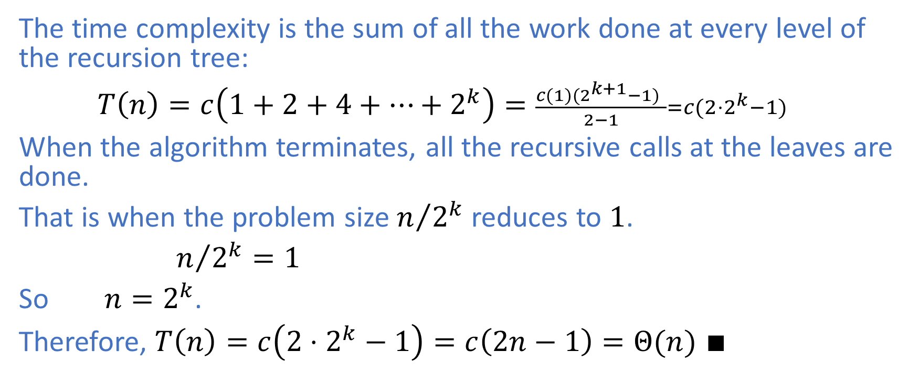
The Recursion Tree Method
The time complexity is the sum of all the work done at every level of the recursion tree:
$T\left(n\right)=c\left(1+2+4+…+2^{k}\right)=\frac{c(1)(2^{k+1}−1) }{2−1}=c({2⋅2}^{k}−1)$
When the algorithm terminates, all the recursive calls at the leaves are done.
That is when the problem size $n/{2^{k}}$ reduces to $1$.
$n/{2^{k}}=1$
So $n=2^{k}$.
Therefore, $T\left(n\right)=c\left({2⋅2}^{k}−1\right)=c\left(2n−1\right)=Θ(n)$ $∎$

Slide 46
Summary
Advantages:
Many algorithms can be naturally implemented using recursion and hence can be coded faster.
Recursive code tends to be more concise and more easily understood.
Disavantages:
Recursive algorithms require additional space for stack frames.
The space complexity is proportional to the maximum depth of recursive calls.
It incurs additional call overhead that can potentially increase running time.

Slide 47
More on solving recurrence relations
We will encounter situations where we need to solve recurrence relations later as we progress through the course.
Master Theorem will be introduced when we talk about the divide and conquer strategy.
Next time, we will cover data structures.

